Slide 1
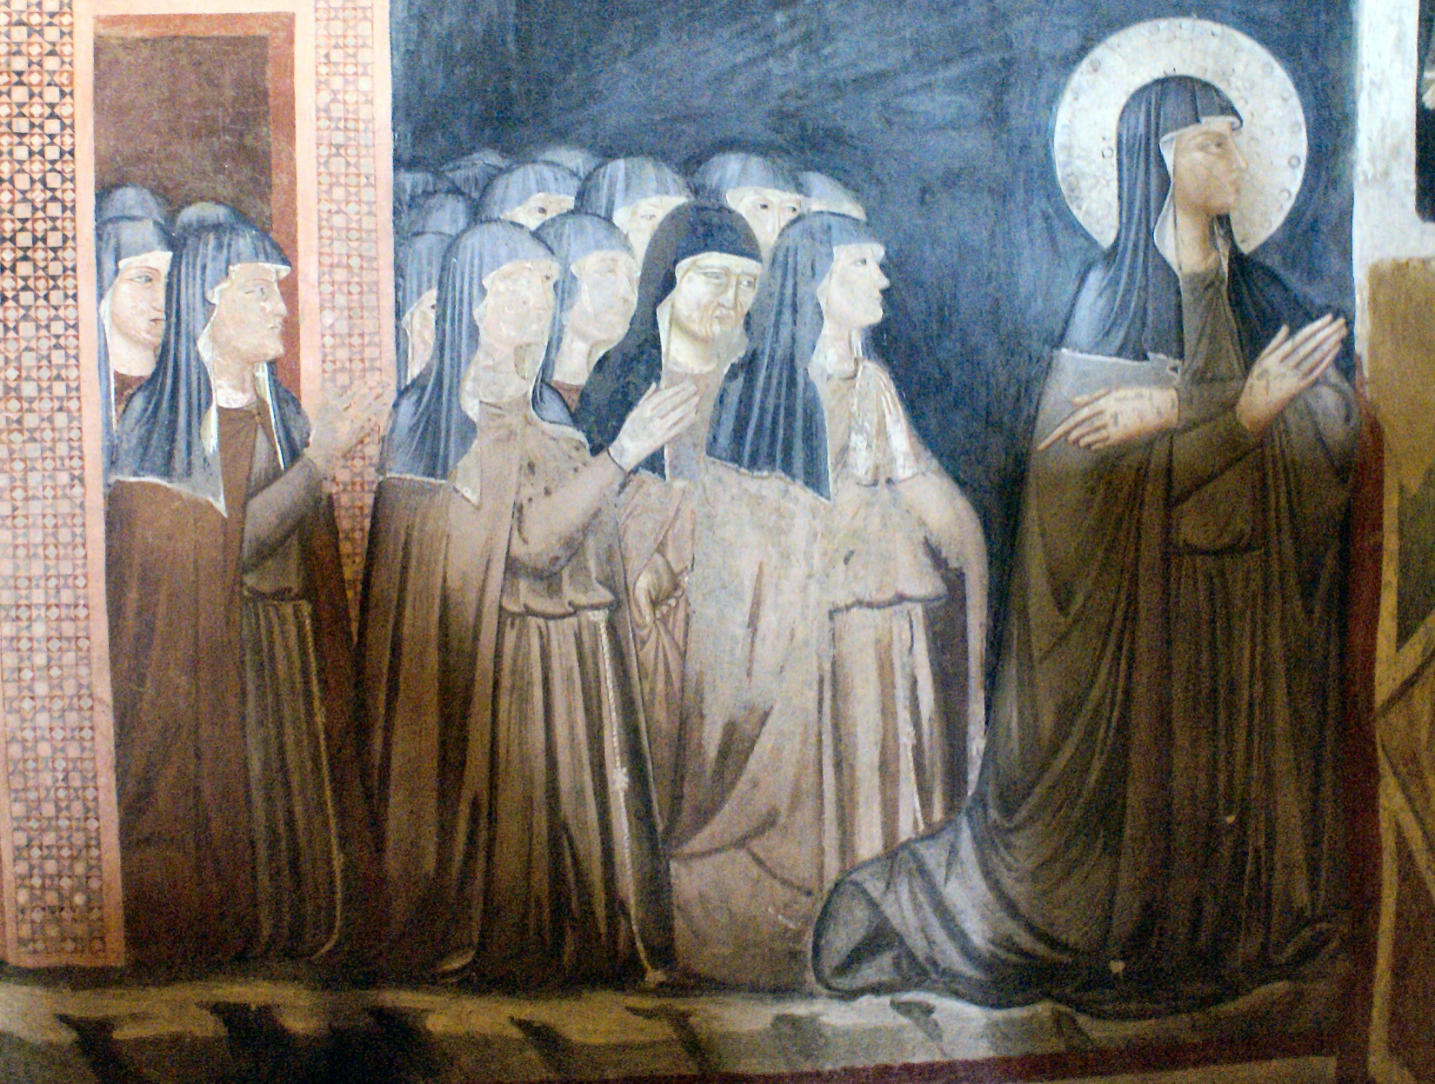
St. Clare of Assisi

Slide 2
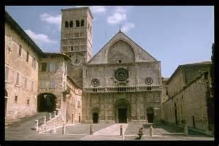
Clare’s Home Adjoined to the Cathedral of San Rufino

Slide 3
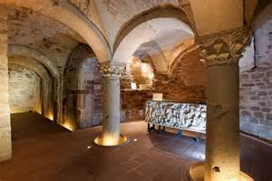
Roman Ruins Beneath the
Cathedral of San Rufino

Slide 4
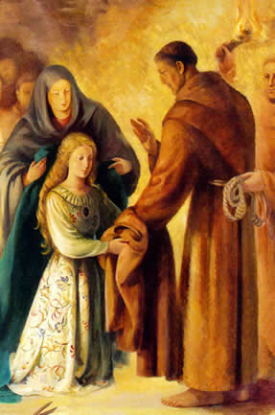
St. Francis Receives Clare at the Portiuncula

Slide 5
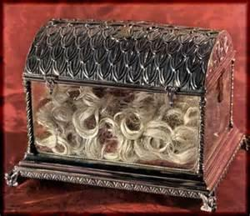
Clare’s Hair from Tonsure

Slide 6
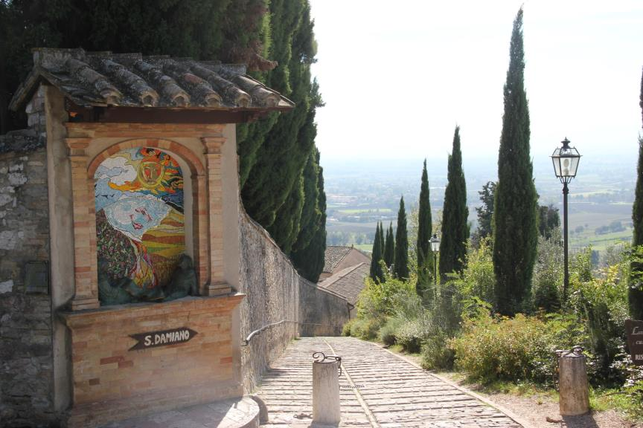
Path to Monastery of San Damiano

Slide 7
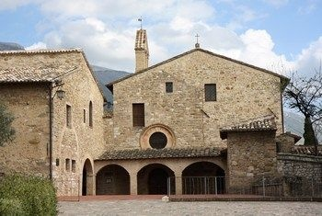
Monastery of San Damiano

Slide 8
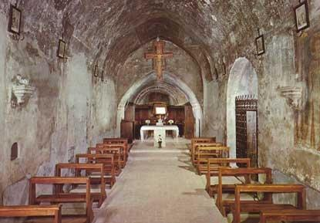
Church of San Damiano

Slide 9
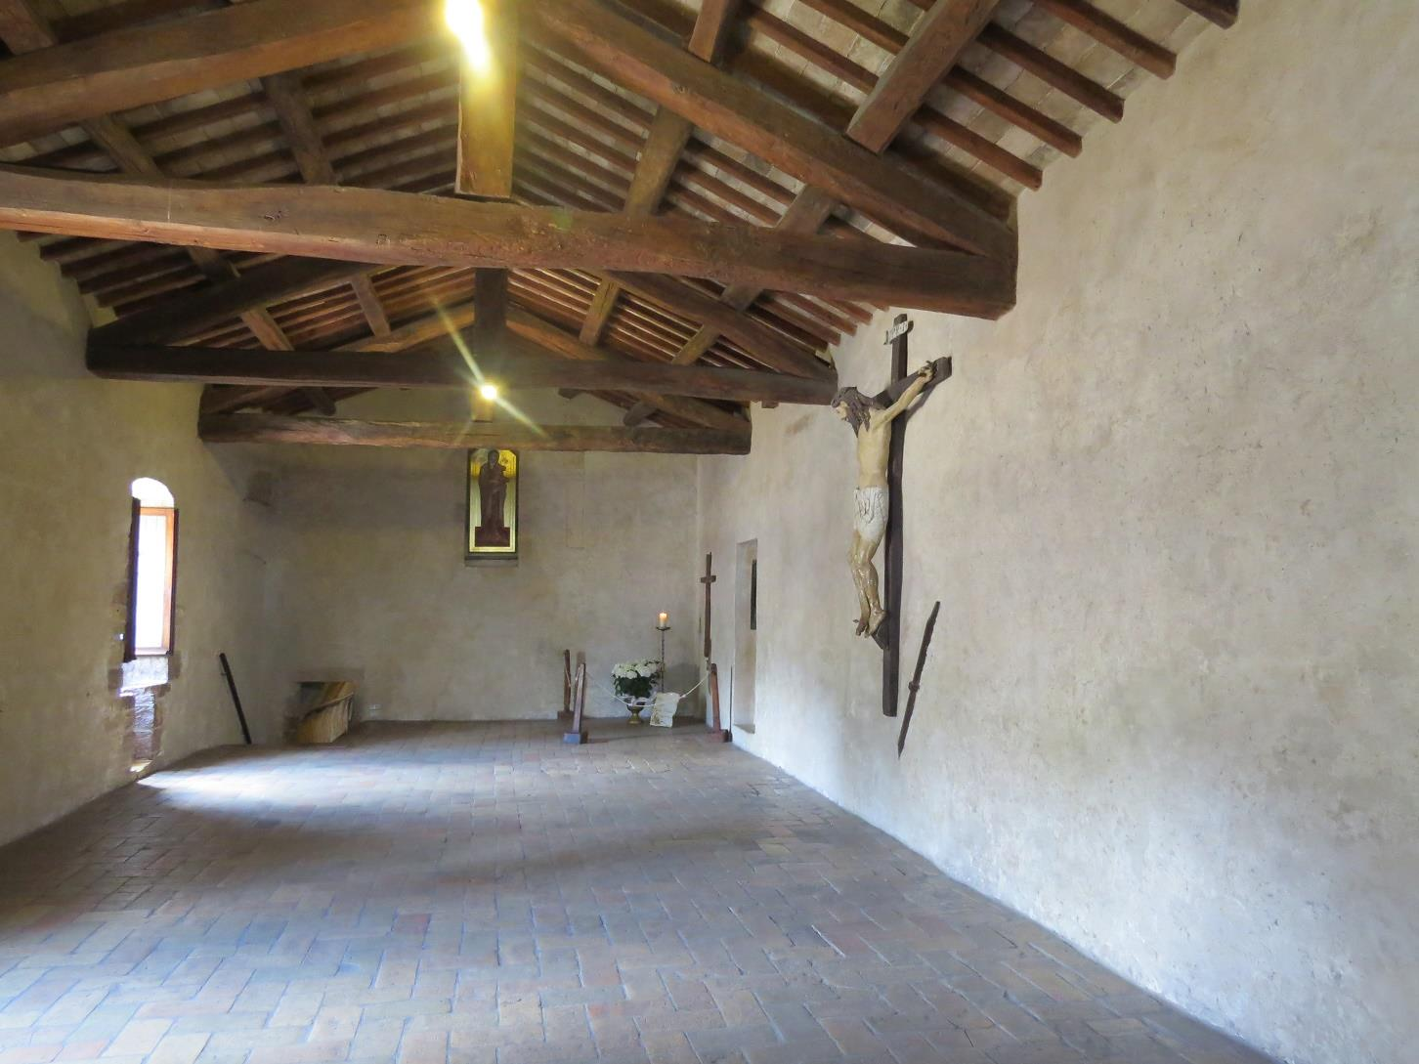
Monastery Dormitory

Slide 10
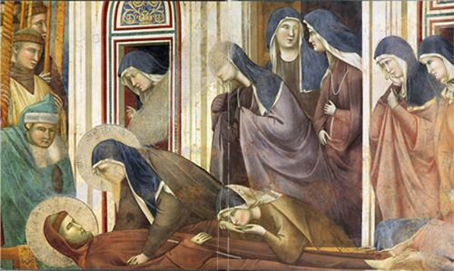
Clare and Her Sisters Mourning
St. Francis’ Death

Slide 11
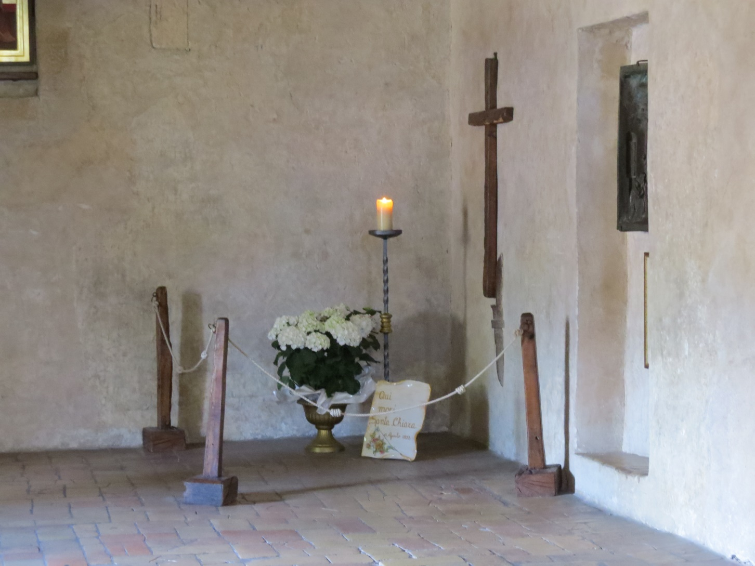
“Blessed be God for Creating Me”

Slide 12
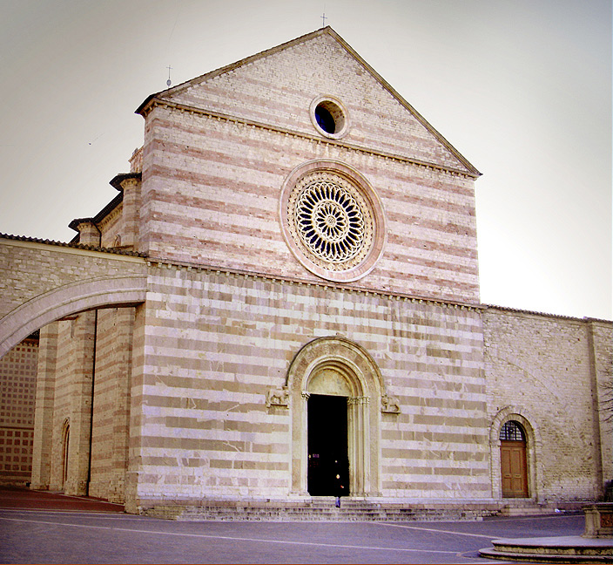
Basilica di Santa Chiara

Slide 13
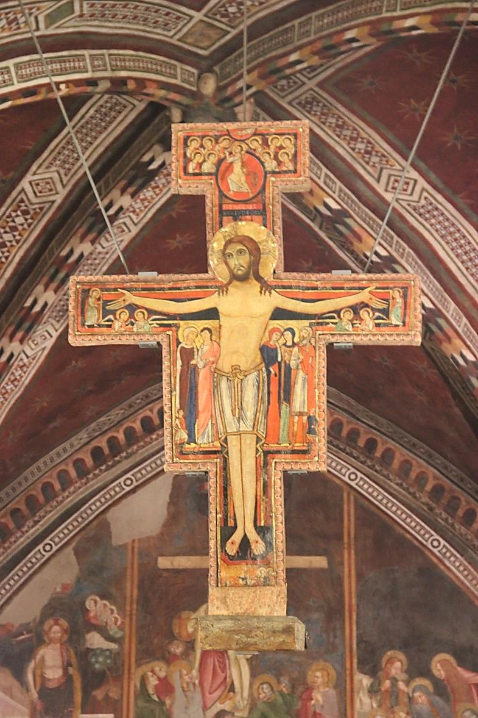
Original San Damiano Cross

Slide 14
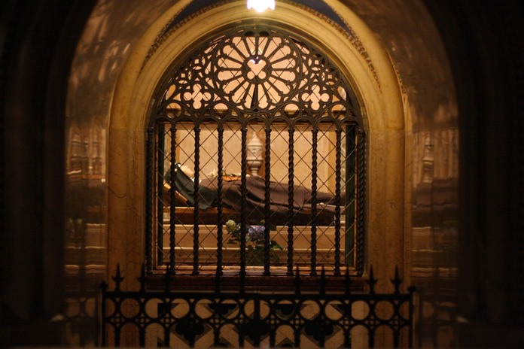
Tomb of St. Clare

Slide 15
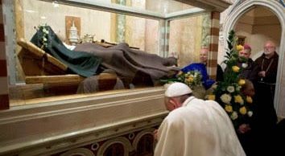
Pope Francis at Tomb of St. Clare

Slide 16
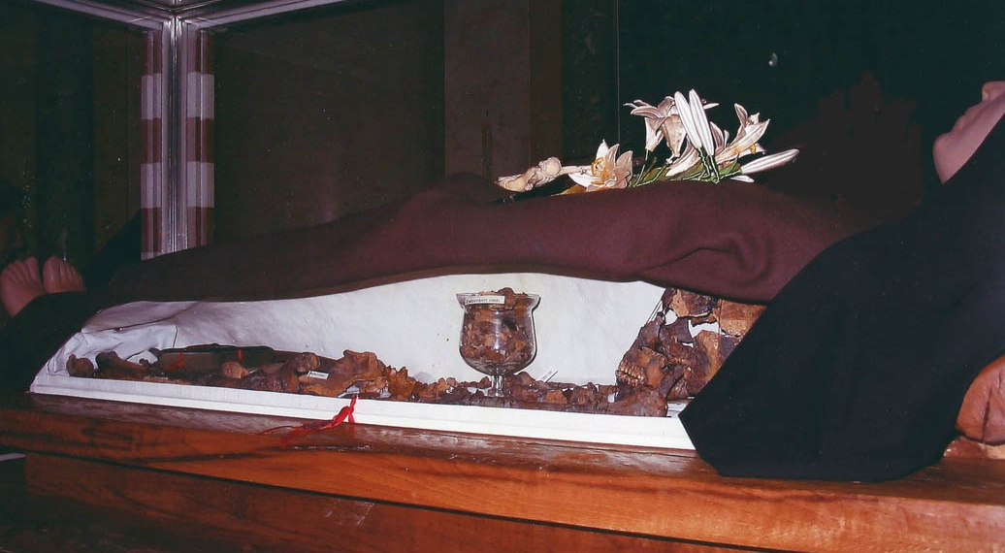
St. Clare’s Remains

Slide 17
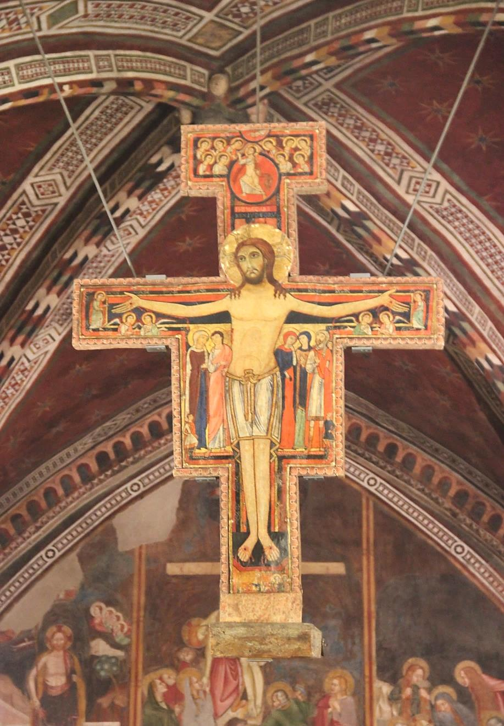
Cross

Slide 18
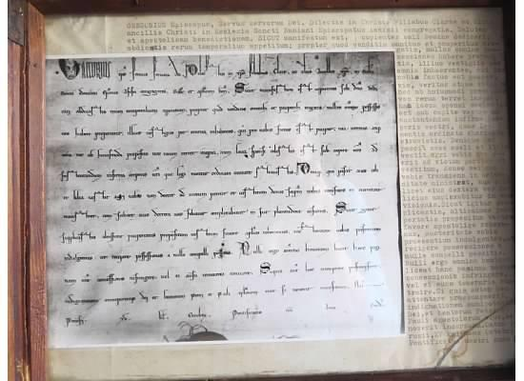
The Privilege of Poverty
Original Document

Slide 19
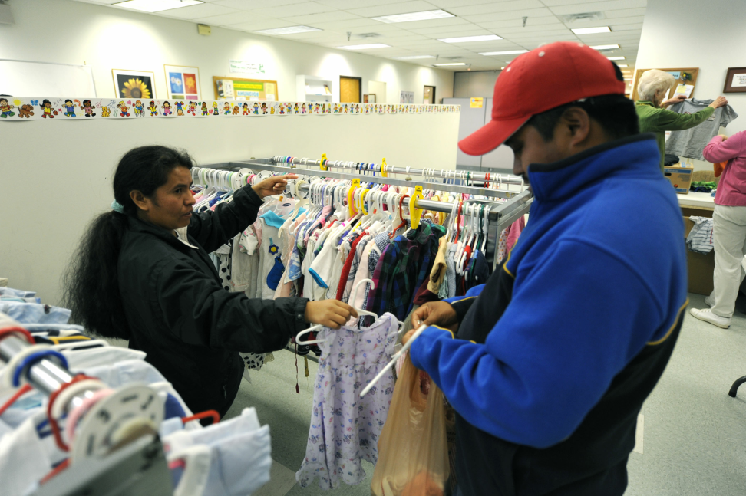
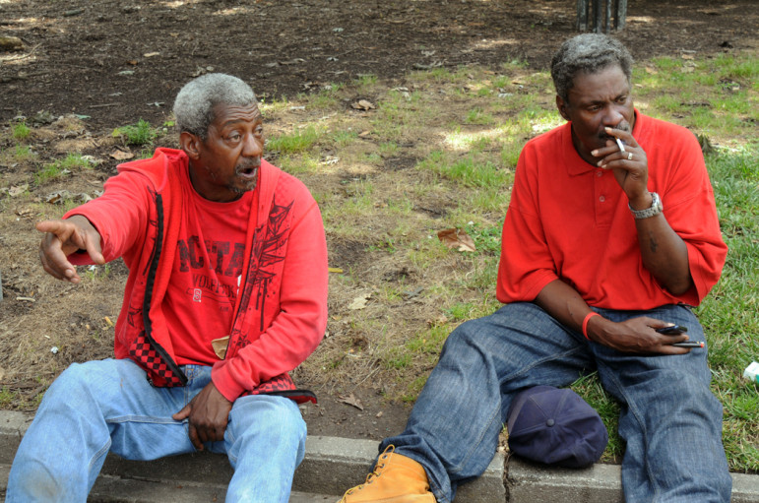
Love of the Poor Crucified Christ
Clare Embodied the Beatitudes
“View From the Bottom”

Slide 20
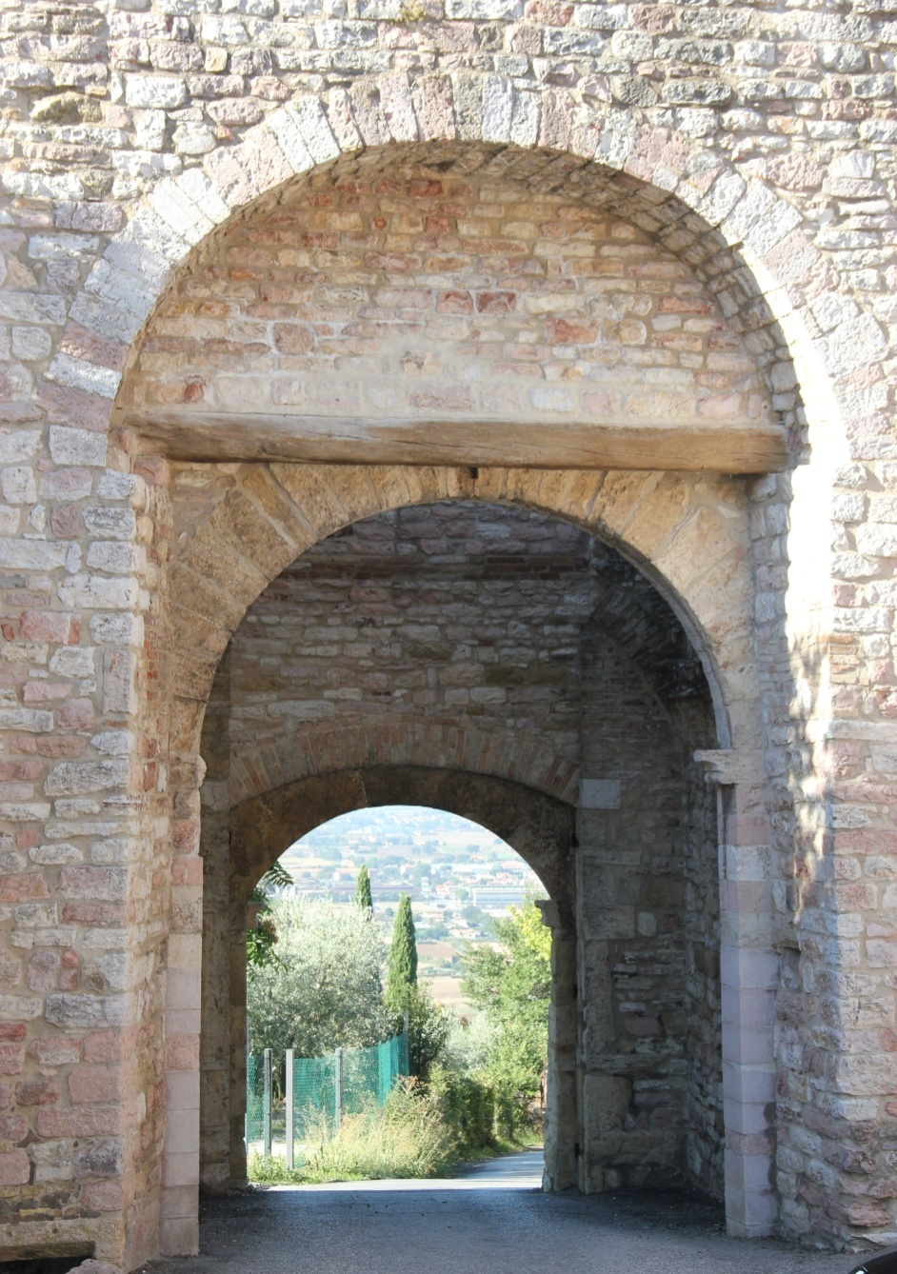
Conversion

Slide 21
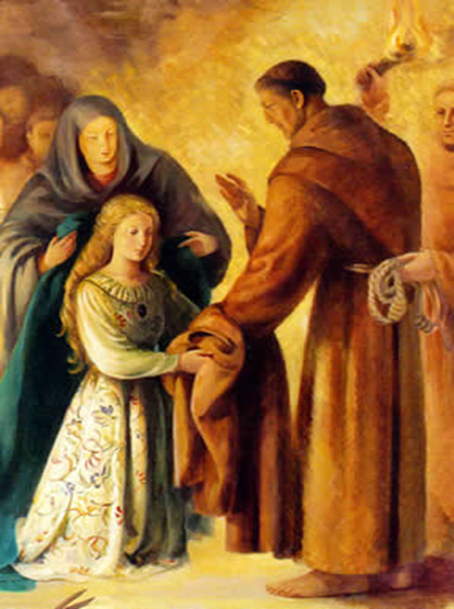
Clare’s New Way of Life

Slide 22
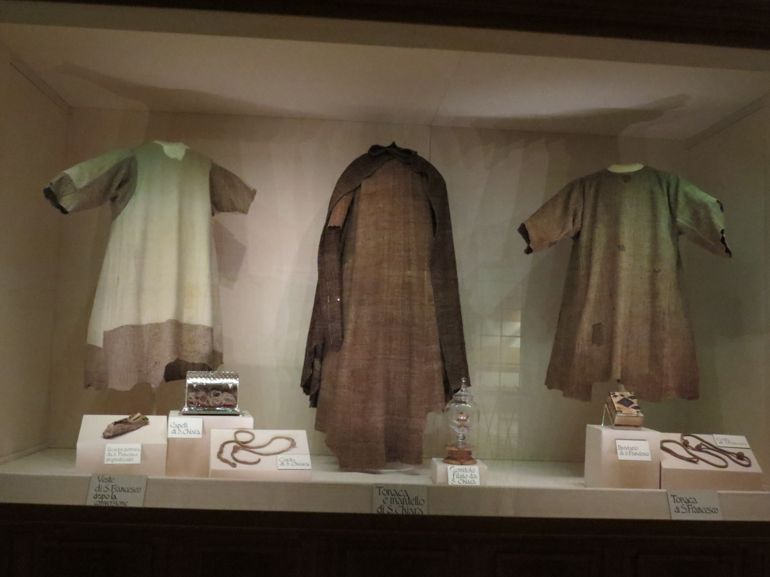
Reliquary of Francis and Clare

Slide 23
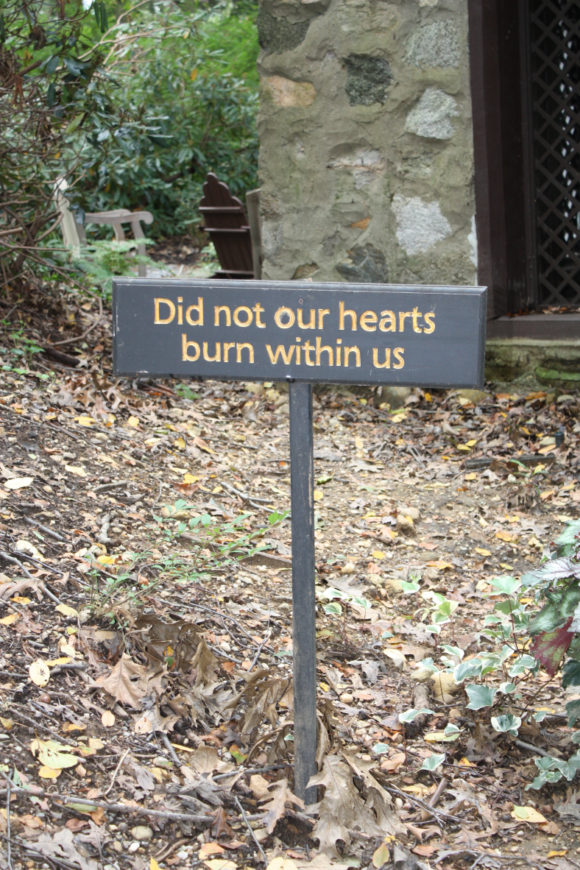
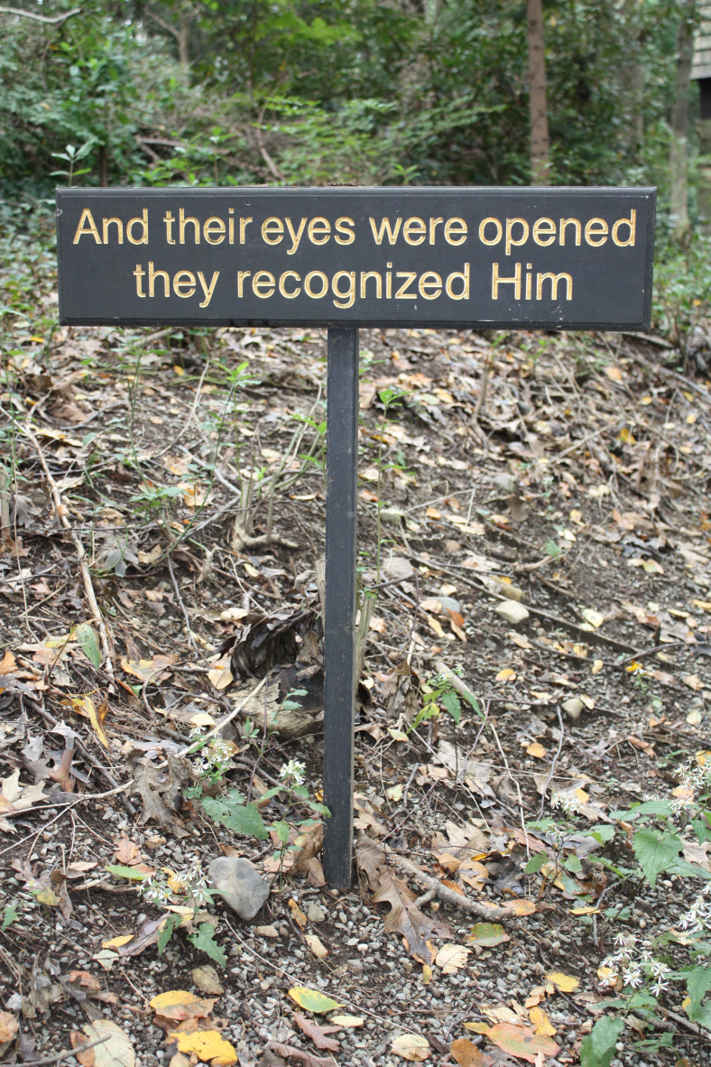
Conversion – To Be Transformed Into
The Image of the Poor Crucified Christ

Slide 24
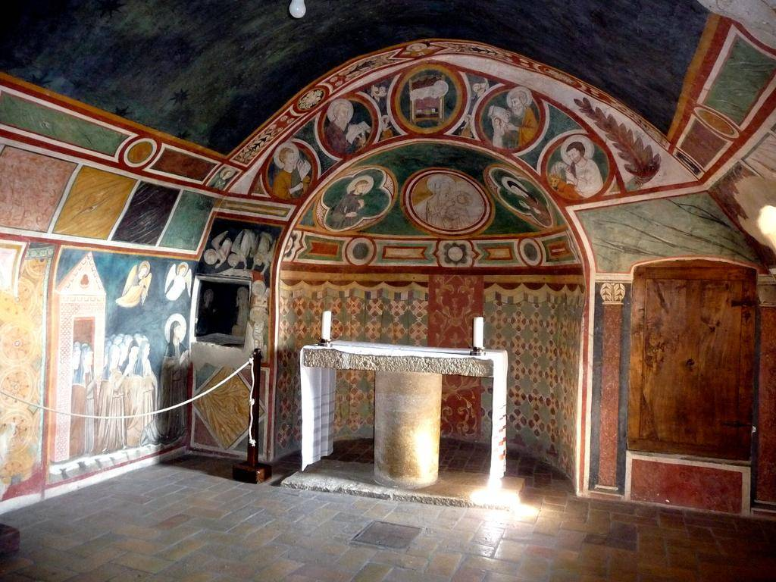
Charism

Slide 25
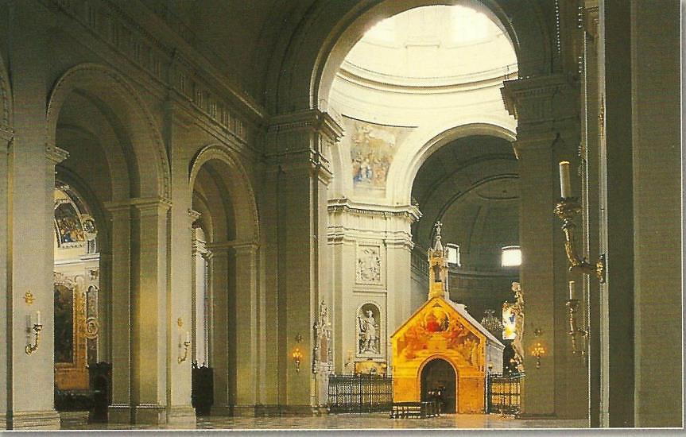
The Porziuncola
Poverty, Peace, Prayer

Slide 26
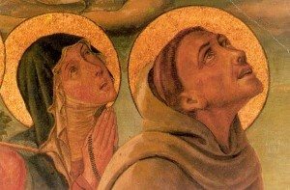
Co-Founders of Franciscanism

Slide 27
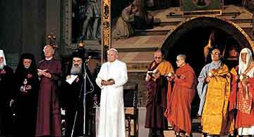
The Porziuncola
1986 World Day of Peace

Slide 28
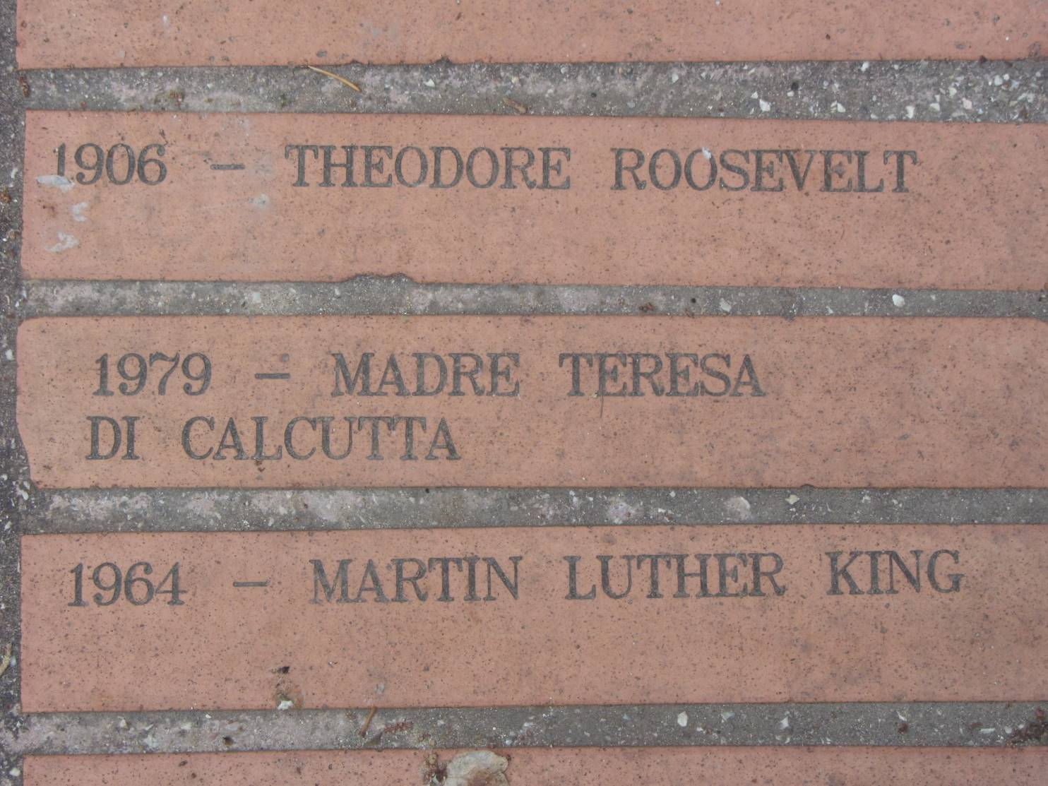
Path from Assisi to the Portiuncula

